Slide 1
DEV JATINBHAI PATEL
20CEUOS018
CE076
DBMS ASSIGNMENT - 4

Slide 2
1. Create the Sales_master table
create table sales_master( salesman_no varchar2(6)CHECK(salesman_no LIKE 'S%'),
sal_names varchar2(20)NOT NULL,
Address1 varchar2(20)NOT NULL,
Address2 varchar2(30)NOT NULL,
city varchar2(20),
pincode varchar2(6),
state varchar2(20),sal_amt number(8,2)NOT NULL,
tgt_to_get number(6,2)NOT NULL,
ytd_sales number(6,2)NOT NULL,
remarks varchar2(30),
PRIMARY KEY(salesman_no),
CHECK(tgt_to_get !=0),
CHECK(sal_amt !=0),
CHECK(ytd_sales!=0 )
);

Slide 3
insert into sales_master (salesman_no,sal_names ,Address1 ,Address2,city ,pincode,state ,sal_amt ,tgt_to_get,ytd_sales ,remarks)VALUES('S00001', 'Aman', 'A/14', 'Worli', 'Mumbai', '400002', 'Maharashtra', '3000', '100', '50', 'Good');
insert into sales_master (salesman_no,sal_names ,Address1 ,Address2,city ,pincode,state ,sal_amt ,tgt_to_get,ytd_sales ,remarks)VALUES('S00002', 'Omkar', '65', 'Nariman', 'Mumbai', '400001', 'Maharashtra', '3000', '200', '100', 'Good');
insert into sales_master (salesman_no,sal_names ,Address1 ,Address2,city ,pincode,state ,sal_amt ,tgt_to_get,ytd_sales ,remarks)VALUES('S00003', 'Raj', 'P-7', 'Bandra', 'Mumbai', '400032', 'Maharashtra', '3000', '200', '100', 'Good');
insert into sales_master (salesman_no,sal_names ,Address1 ,Address2,city ,pincode,state ,sal_amt ,tgt_to_get,ytd_sales ,remarks)VALUES('S00004', 'Ashish', 'A/5', 'Juhu', 'Mumbai', '400044', 'Maharashtra', '3500', '200', '150', 'Good');

Slide 4
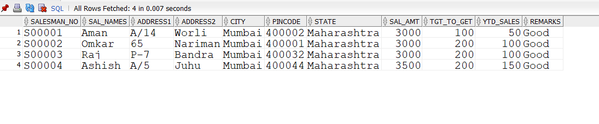

Slide 5
2.Create the Sales_order table:
create table sales_order(
s_order_no varchar2(6)CHECK(s_order_no LIKE 'O%'),
Order_date Date NOT NULL,Client_no varchar2(6),
Dely_add varchar2(25),
Salesman_no Varchar2(6),
Dely_type Char(1) default('F'),
Bill_yn char(1),
Dely_date date,Order_status Varchar2(10),
CHECK(Order_date<Dely_date),
CHECK(Order_status IN('in process','fulfilled','back order','cancelled')),
PRIMARY KEY (s_order_no),
FOREIGN KEY(Salesman_no)REFERENCES sales_master,
FOREIGN KEY(Client_no)REFERENCES client_master,
CHECK(Dely_type IN('P','F'))
);

Slide 6
insert into sales_order(s_order_no,Order_date,Client_no,Dely_add,Salesman_no,Dely_type,Bill_yn,Dely_date,Order_status)VALUES('O19001', '12-jan-96', '0001', '-', 'S00001', 'F', 'N', '20-jan-96', 'in process');
insert into sales_order(s_order_no,Order_date,Client_no,Dely_add,Salesman_no,Dely_type,Bill_yn,Dely_date,Order_status)VALUES('O19002', '25-jan-96', '0002', '-', 'S00002', 'P', 'N', '27-jan-96', 'cancelled');
insert into sales_order(s_order_no,Order_date,Client_no,Dely_add,Salesman_no,Dely_type,Bill_yn,Dely_date,Order_status)VALUES('O16865', '18-feb-96', '0003', '-', 'S00003', 'F', 'Y', '20-feb-96', 'fulfilled');
insert into sales_order(s_order_no,Order_date,Client_no,Dely_add,Salesman_no,Dely_type,Bill_yn,Dely_date,Order_status)VALUES('O19003', '03-apr-96', '0001', '-', 'S00001', 'F', 'Y', '07-apr-96', 'fulfilled');
insert into sales_order(s_order_no,Order_date,Client_no,Dely_add,Salesman_no,Dely_type,Bill_yn,Dely_date,Order_status)VALUES('O46866', '20-may-96', '0004', '-', 'S00002', 'P', 'N', '22-may-96', 'cancelled');
insert into sales_order(s_order_no,Order_date,Client_no,Dely_add,Salesman_no,Dely_type,Bill_yn,Dely_date,Order_status)VALUES('O10008', '24-may-96', '0005', '-', 'S00004', 'F', 'N', '26-may-96', 'in process');

Slide 7
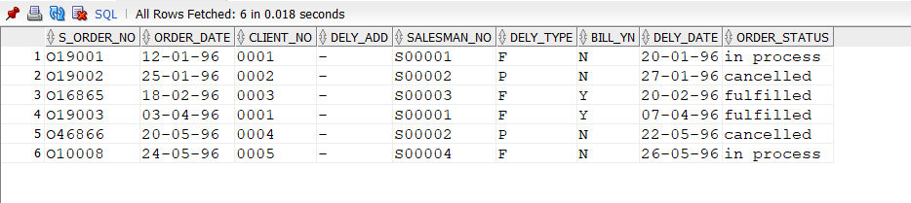

Slide 8
3.create table Sales_order_details(
S_order_no varchar2(6),
Product_no varchar2(6),
Qty_order number(8),
Qty_disp number(8),
Product_rate number(10,2),
FOREIGN KEY(S_order_no)REFERENCES sales_order,
FOREIGN KEY(Product_no)REFERENCES Product_master
);

Slide 9
insert into Sales_order_details(S_order_no,Product_no,Qty_order,Qty_disp,Product_rate) VALUES('O19001', 'P00001', '4', '4', '525');
insert into Sales_order_details(S_order_no,Product_no,Qty_order,Qty_disp,Product_rate) VALUES('O19001', 'P07965', '2', '1', '8400');
insert into Sales_order_details(S_order_no,Product_no,Qty_order,Qty_disp,Product_rate) VALUES('O19001', 'P07885', '2', '1', '5250');
insert into Sales_order_details(S_order_no,Product_no,Qty_order,Qty_disp,Product_rate) VALUES('O19002', 'P00001', '10', '0', '525');
insert into Sales_order_details(S_order_no,Product_no,Qty_order,Qty_disp,Product_rate) VALUES('O16865', 'P07868', '3', '3', '3150');
insert into Sales_order_details(S_order_no,Product_no,Qty_order,Qty_disp,Product_rate) VALUES('O16865', 'P07885', '10', '10', '5250');
insert into Sales_order_details(S_order_no,Product_no,Qty_order,Qty_disp,Product_rate) VALUES('O19003', 'P00001', '4', '4', '1050');
insert into Sales_order_details(S_order_no,Product_no,Qty_order,Qty_disp,Product_rate) VALUES('O19003', 'P03453', '2', '2', '1050');
insert into Sales_order_details(S_order_no,Product_no,Qty_order,Qty_disp,Product_rate) VALUES('O46866', 'P06734', '1', '1', '12000');
insert into Sales_order_details(S_order_no,Product_no,Qty_order,Qty_disp,Product_rate) VALUES('O46866', 'P07865', '1', '0', '8400');
insert into Sales_order_details(S_order_no,Product_no,Qty_order,Qty_disp,Product_rate) VALUES('O10008', 'P07975', '1', '0', '1050');
insert into Sales_order_details(S_order_no,Product_no,Qty_order,Qty_disp,Product_rate) VALUES('O10008', 'P00001', '10', '5', '525');

Slide 10



